Slide 1
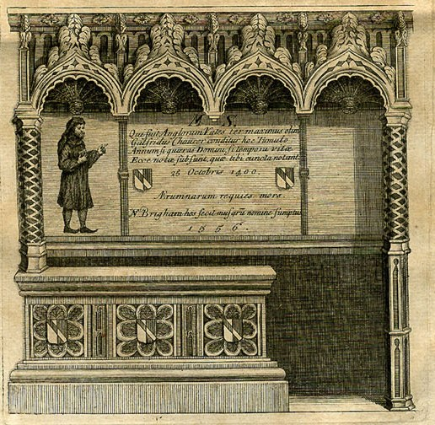
Writing Fame: Renaissance Chaucer Editions’ Epitaph Transcriptions and the Construction of Chaucer Arnold Sanders, Goucher College, 2010

Slide 2
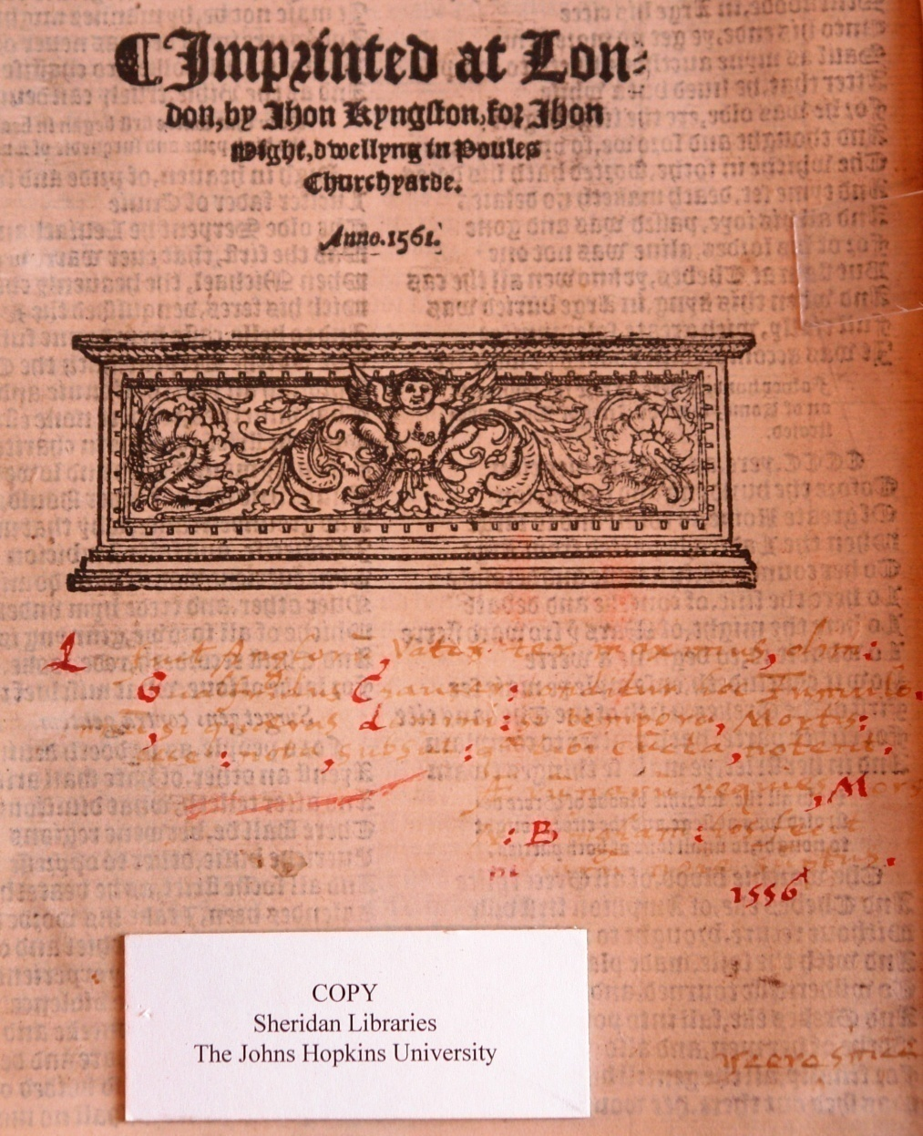
The Workes of Geffrey Chaucer, newlie printed, with diuers addicions, whiche were neuer in print before; with the siege and destruction of the worthy Citee of Thebes, compiled by Ihon Lidgate, Monk of Berie. As in the tale more plainly doeth appere. 1561. London: John Stowe, 1561. Garrett Library (Johns Hopkins U.), Tudor and Stuart Club Copy

Slide 3
He who was once the thrice greatest English poet, Geoffrey Chaucer, is buried in this grave if you ask the year of the Lord, the period of his death, look at what is written below, which tells you all. The relief of all troubles is death. Nicholas Brigham assumed these expenses in the name of the Muses. 1556
Qui fuit Anglor<um> vates ter maximus, olim:
Galfridus Chaucer, conditur hoc Tumulo
Ann<um>, si queras domini: si tempora, Mortis:
ecce: nota, subsunt: [que?] tibi cuncta, notant.
Æ<um>mar<um> requies, Mors.
N: B[ri?]gam: hos fecit [?musarum sumptus]
1556

Slide 4
The Workes of Geffrey Chaucer, newlie printed, with diuers addicions, whiche were neuer in print before; with the siege and destruction of the worthy Citee of Thebes, compiled by Ihon Lidgate, Monk of Berie. As in the tale more plainly doeth appere. 1561. London: John Stowe, 1561. Garrett Library (Johns Hopkins U.), John Work Garrett copy

Slide 5
The wordes writtin a bout Chaucers tombe ſtone in Weſt<minster> Si rogites quis eram, forſan te fama docebit quod ſi fama negat, mundi quia gloria tranſit hec monumenta lege Qui fuit Anglorum Chaucers epitaphe [written over cancelled first line] written in West<minster> upon his tombe Qui fuit Anglon vates ter maximus olim Galfridis Chaucer conditur hoc tumulo An<n>um ſi queras d<omi>ni si tempora mortis ecce nota ſubſunt, qui tibi cuncta notant 25 octob<e>r a<n>o D<omi>ni 1400 Ærrumar<um> requies mors N: Brigham hos fecit musſar<um> <nomine> sumptus 1556 } wordis also writtin upon chaucers stone

Slide 6
1994: Joseph A. Dane's epitaph discovery at the foot of the title page's printers ornament in a Kele 1550 edition at The Henry Huntington Library

Slide 7
1994: Alexandra Gillespie's epitaph discovery on the colophon page of a 1561 Stow edition at the Harry T. Ransome Center Library (U. of Texas at Austin)

Slide 8
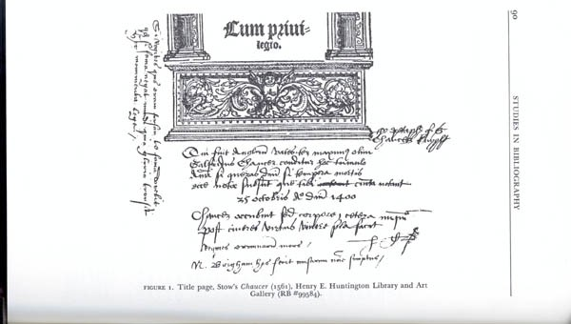
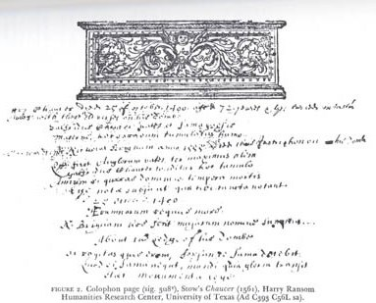
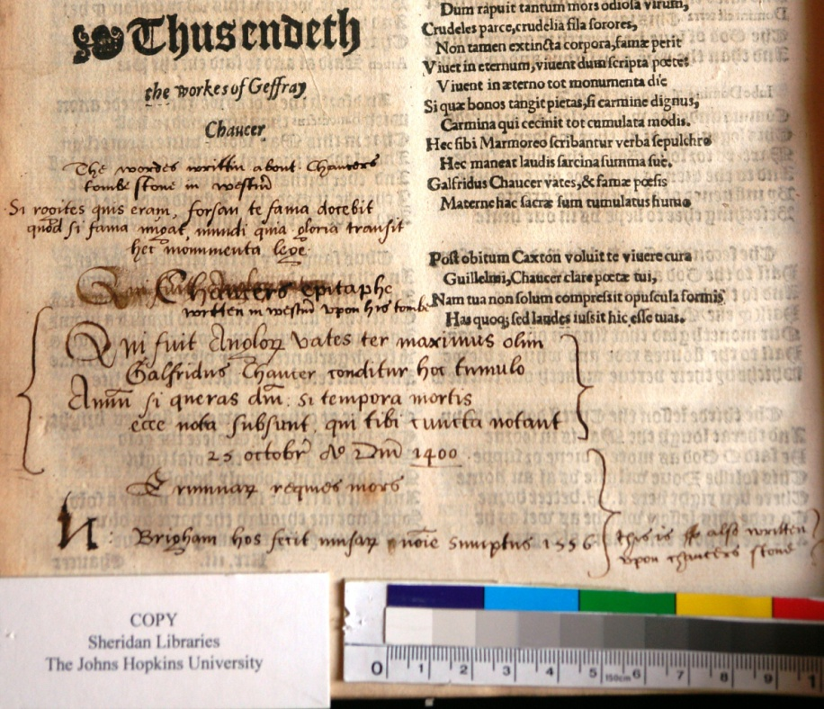
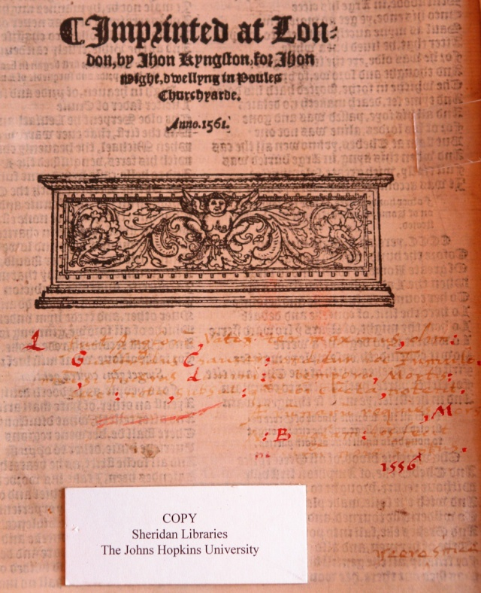
Dane / Huntington / Thorpe 1532 Gillespie / Ransome Center / Stowe 1561
Sanders / Garrett Lib 2 / Stowe 1561 Sanders / Garrett Lib 1 / Stowe 1561

Slide 9
Current Known Chaucer Epitaph Transcriptions by Early Modern Readers in Chaucer Collected Works Editions
1532 Thynne Edition, Allison Wiggins, Folger Shakespeare Library (2008)
1532 Thynne Edition copy 2, Allison Wiggins and Arnold Sanders, Folger Shakespeare Library (2008/2009)
1550 Kele reprint of Thynne Edition, Joseph A. Dane, Huntington Library (1994)
1561 Stowe Edition, Alexandra Gillespie, Harry Ransome Center, U.T., Austin (1994)
1561 Stowe Edition, Allison Wiggins, Folger Shakespeare Library (2008)
1561 Stowe Edition, J.W. Garrett copy, Arnold Sanders, Garrett Library, Johns Hopkins U. (2009)
1561 Stowe Edition, Tudor and Stuart Club copy, Arnold Sanders, Garrett Library, Johns Hopkins U. (2009)

Slide 11
The Works of Geoffrey Chaucer : compared with the former editions, and many valuable mss. out of which, three tales are added which were never before printed / by John Urry, student of Christ-Church, Oxon. deceased; together with a glossary by a student of the same College. To the whole is prefixed the author's life, newly written, and a preface, giving an account of this edition. London: Bernard Lintot, 1721.

Slide 12
Franklin D. Roosevelt Memorial, Washington, D.C.

Slide 13
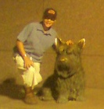
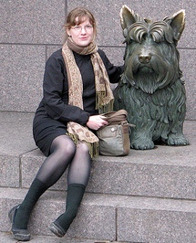
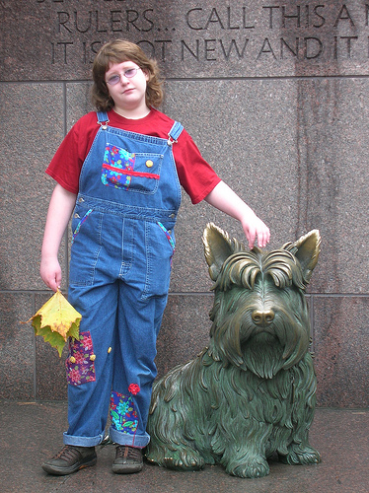
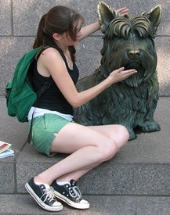
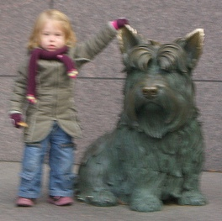
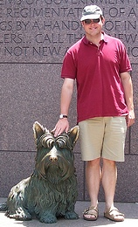
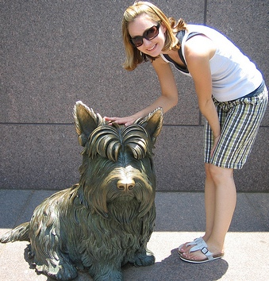
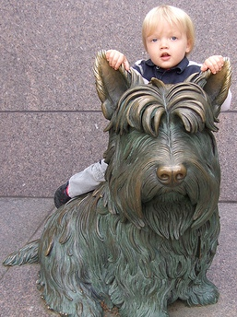
The Modern “Fala” Cultus (images from Flickr.com, 5/10/10)

Slide 14
Petworth (“Paludina”) Marble

Slide 15
Weathered Petworth (“Paludina”) Marble

Slide 16
Edmund Spenser, The Faerie Queene, Book IV, Canto ii, Stanzas 32-33
Whylome as antique stories tellen vs, Those two were foes the fellonest on ground, And battell made the dreddest daungerous, That euer shrilling trumpet did resound; Though now their acts be no where to be found, As that renowmed Poet them compyled, With warlike numbers and Heroicke sound, Dan Chaucer, well of English vndefyled, On Fames eternall beadroll worthie to be fyled. But wicked Time that all good thoughts doth waste, And workes of noblest wits to nought out weare, That famous moniment hath quite defaste, And robd the world of threasure endlesse deare, The which mote haue enriched all vs heare. O cursed Eld the cankerworme of writs, How may these rimes, so rude as doth appeare, Hope to endure, sith workes of heauenly wits Are quite deuourd, and brought to nought by little bits?

Slide 17
Spenser’s Tomb Verses
Hic prope Chaucerum situs est Spenserius, illi
Proximus ingenio proximus ut tumulo.
Hic prope Chaucerum, Spensere poeta, poetam
Conderis, et versu quam tumulo propior.
Anglica, te vivo, vixit plausitque poesis;
Here nigh to Chaucer Spenser lies; to whom
In genius next he was, as now in tomb.
Here nigh to Chaucer, Spenser, stands thy hearse,
Still nearer standst thou to him in thy verse.
Whilst thou didst live, lived English poetry;
Now thou art dead, it fears that it shall die.

Slide 18
Spenser, Edmund. The Works of that Famous English Poet, Mr. Edmund Spenser. London: by Henry Hills for Jonathan Edwin, 1679.

Slide 19
Does your library’s rare book collection contain a 1532-1598 Chaucer? Please email asanders@goucher.edu

